Slide 1
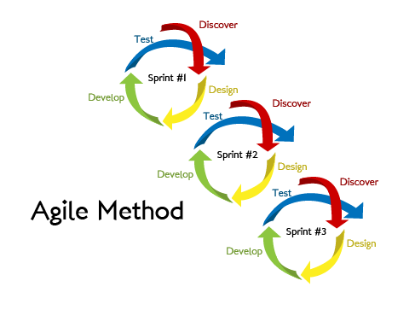
Project Integration Management
School of Computer and Security Science
CSG2344 Project methods and Professionalism
Agile Project Management (Agile Part 1)
ECU Copyright 2015 – CSG 2344 School of Computer and Security Science

Slide 2
Traditional versus Agile
Agile has several major differences to Traditional Project Management
Traditional PM treats Scope as King. Anything outside of the scope is to be ignored … and the project team actively try to retain the project with the same scope.
Agile sees change as good. It looks to develop the scope as the project proceeds.
To do this Agile uses the MoSCoW principle.
ECU Copyright 2015 – CSG 2344 School of Computer and Security Science

Slide 3
Traditional versus Agile
Traditional Project Approach
Agile Approach
Scope
Time
Cost
Quality
Quality
Time
Cost
Scope
ECU Copyright 2015 – CSG 2344 School of Computer and Security Science

Slide 4
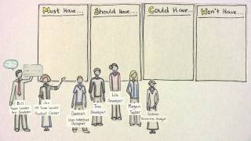
MoSCoW Principle
M – Must Have
S – Should Have
C – Could Have
W – Wont Have
(right now)
ECU Copyright 2015 – CSG 2344 School of Computer and Security Science

Slide 5
8 Agile Project Principles (non negotiable rules)
Focus on the Business Need
Deliver on Time
Collaborate
Never Compromise Quality
Build incrementally from Firm foundations
Develop Iteratively
Communicate Continuously and Clearly
Demonstrate Control
ECU Copyright 2013 – CSG2344 School of Computer and Security Science
ECU Copyright 2015 – CSG 2344 School of Computer and Security Science

Slide 6
Principle 1
Focus on the Business Need
Decisions are based around project goals (not wants)
Clear understanding of the business priorities (ie the MoSCoW rules)
Guarantee Minimum Useable SubseT ( MUST Haves)
Supported by Business roles and agreed products
ECU Copyright 2015 – CSG 2344 School of Computer and Security Science

Slide 7
Principle 2
Deliver on Time
The team must TIMEBOX the work
Deliver according to MoSCoW
Never move the agreed timeline
ECU Copyright 2013 – CSG2344 School of Computer and Security Science
ECU Copyright 2015 – CSG 2344 School of Computer and Security Science

Slide 8
Principle 3
Collaborate
Involve the Right Stakeholders at the Right Time (throughout the project)
Team members are empowered to make decisions
Actively involve business representatives
Hold Facilitated Workshops
ECU Copyright 2013 – CSG2344 School of Computer and Security Science
ECU Copyright 2015 – CSG 2344 School of Computer and Security Science

Slide 9
Principle 4
Never Compromise Quality
(Fit for Purpose)
The team must set and agree the acceptance criteria
Ensure that quality does NOT become a variable
Design document and test
Test early and often
Constant review by the right people
ECU Copyright 2015 – CSG 2344 School of Computer and Security Science

Slide 10
Principle 5
Build Incrementally from Firm Foundations
(BIFO)
The team must strive for early delivery of business benefit where possible
Continually confirm that the correct solution is being built
Formally re-assess MoSCoW and ongoing project viability at each timebox
ECU Copyright 2015 – CSG 2344 School of Computer and Security Science

Slide 11
Principle 6
Develop Iteratively
Nothing is ever built perfectly 1st time
Enough Design Up Front ( EDUF rule) – do just enough design to be able to make something that can be shown
Embrace and expect change
Agile knows that change is inevitable – harness the benefits
ECU Copyright 2015 – CSG 2344 School of Computer and Security Science

Slide 12
Principle 7
Communicate Continuously and Clearly
The Team MUST run daily stand up sessions
The Team MUST use facilitated Workshops
The Team MUST model and prototype
The Team MUST keep documentation (lean and timely)
The Team MUST have face to face communication at all levels of stakeholder engagement
ECU Copyright 2015 – CSG 2344 School of Computer and Security Science

Slide 13
Principle 8
Demonstrate Control
The Team MUST guarantee Timeboxing
The Team MUST use Burn Down Charts
The Team MUST track Velocity
The Team MUST use technical expertise
ECU Copyright 2015 – CSG 2344 School of Computer and Security Science

Slide 14

Agile Roles
Business Sponsor - ( the project Champion) – he takes risks
Business Visionary – provides strategic direction – guarantees that the business needs ( ie the business case) is on track
Project manager – Focusses on Delivery – communicates with senior management
Technical Coordinator – Has technical Authority for the project
Business Analyst – links the solution development team with senior management
Solution development team – builds the timeboxes – executes the work
Team Leader – leads the Solutions development team ( testers and developers)
ECU Copyright 2015 – CSG 2344 School of Computer and Security Science

Slide 15
Timeboxing
Each Timebox is a planned portion of work
Each time box has a set time
The team is empowered to do what they need to do in the timebox
They must never compromise quality
The project NEVER moves to the next timebox until everyone agrees that the previous timebox is complete.
At the end of the timebox – the next timebox is planned – including what will be done and how much time is needed.l
ECU Copyright 2015 – CSG 2344 School of Computer and Security Science

Slide 16

Timeboxing gone wrong
If a timebox goes wrong – the project stops – and the project manager intervenes.
Nothing goes forward until the timebox has been sorted.
ECU Copyright 2015 – CSG 2344 School of Computer and Security Science

Slide 17
Communication - Daily Standups
Happens every day facilitated by the Team Lead or Project Manager
The whole solutions team participates
Stakeholders are ALWAYS welcome to come and listen and watch
Each Team Member says:
What they have been doing since the last stand up
What they will be doing now before the next stand up
Any problems risks or issues they are encountering that is slowing progress
Usually the stand ups take about 15 minutes ( 2 – 3 minutes per person)
ECU Copyright 2015 – CSG 2344 School of Computer and Security Science

Slide 18
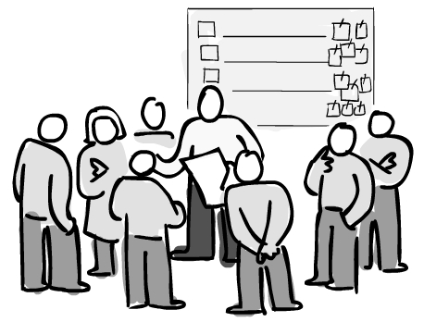
Timeboxing
Identify, Plan, Evolve, Review
Using MoSCoW
Must haves – are required – Should haves are great if there is enough time
ECU Copyright 2015 – CSG 2344 School of Computer and Security Science

Slide 19

Using MoSCoW and Daily Stand Ups
Risk is constantly evaluated
Risk is assessed in each timebox
Stakeholders can identify risk in an ongoing manner
ECU Copyright 2015 – CSG 2344 School of Computer and Security Science

Slide 20
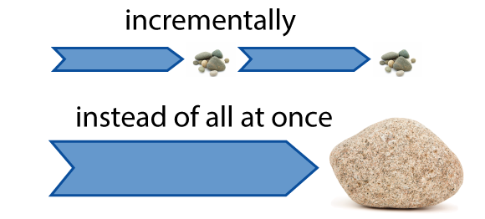
ECU Copyright 2015 – CSG 2344 School of Computer and Security Science

